Slide 1
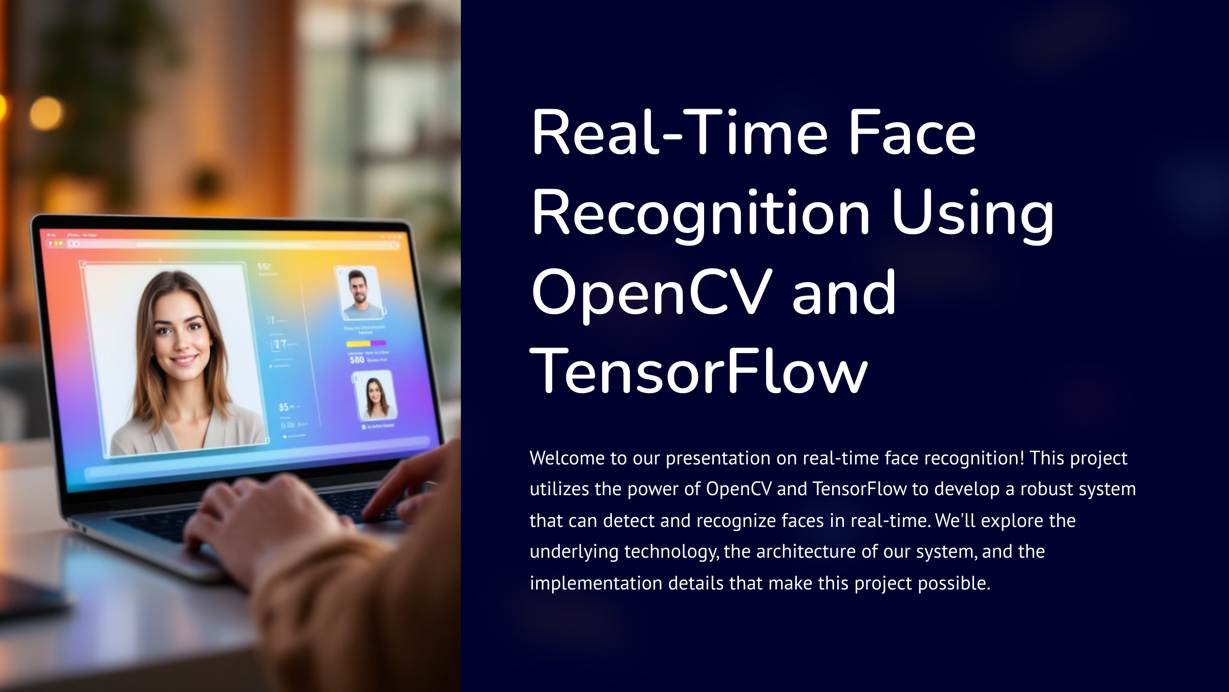

Slide 2


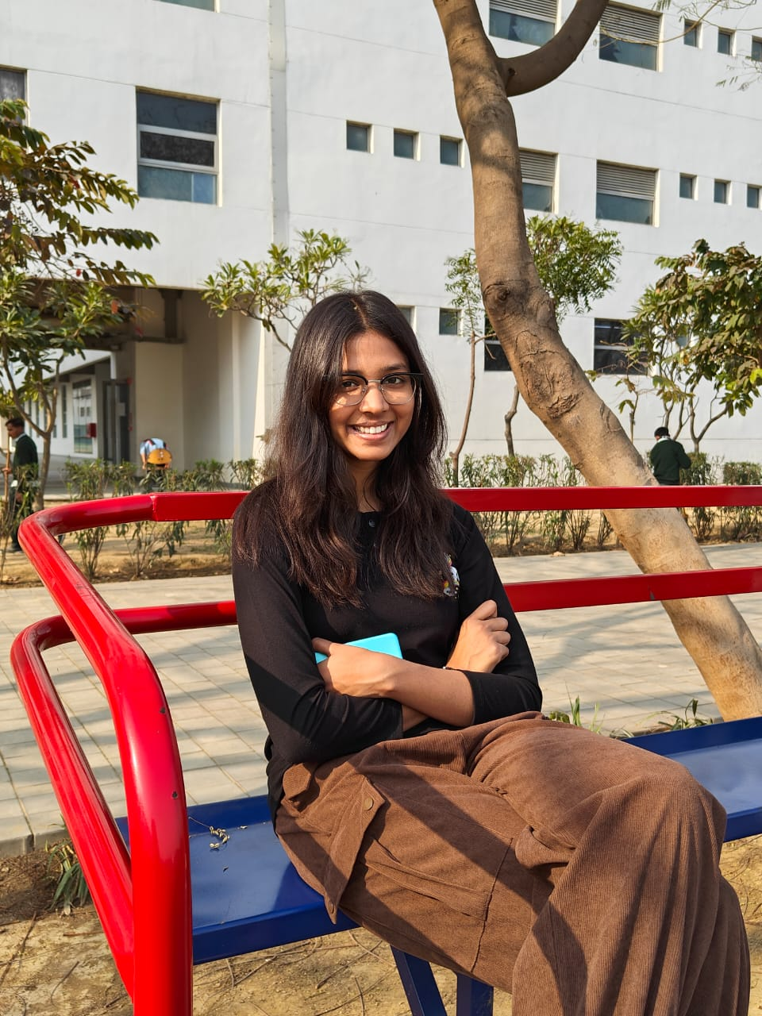

Project Team
Harshit
E23CSEU0433
Khushi Garg
E23CSEU0447
Aryan Chauhan
E23CSEU0442

Slide 3
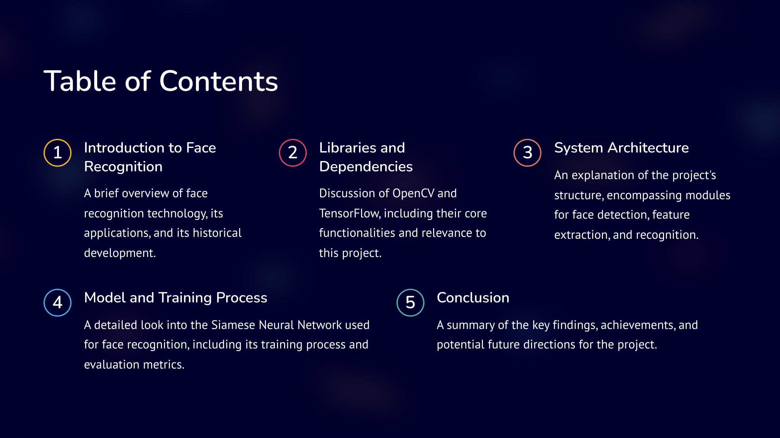

Slide 4
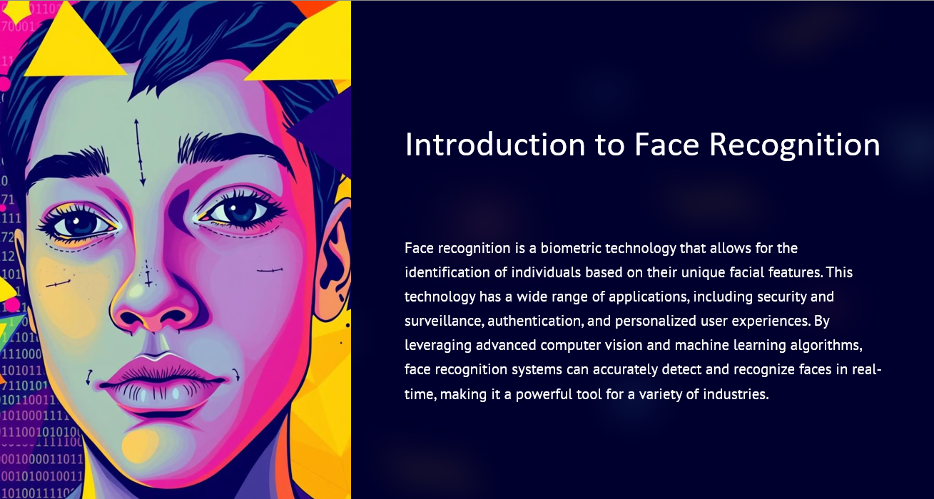

Slide 5
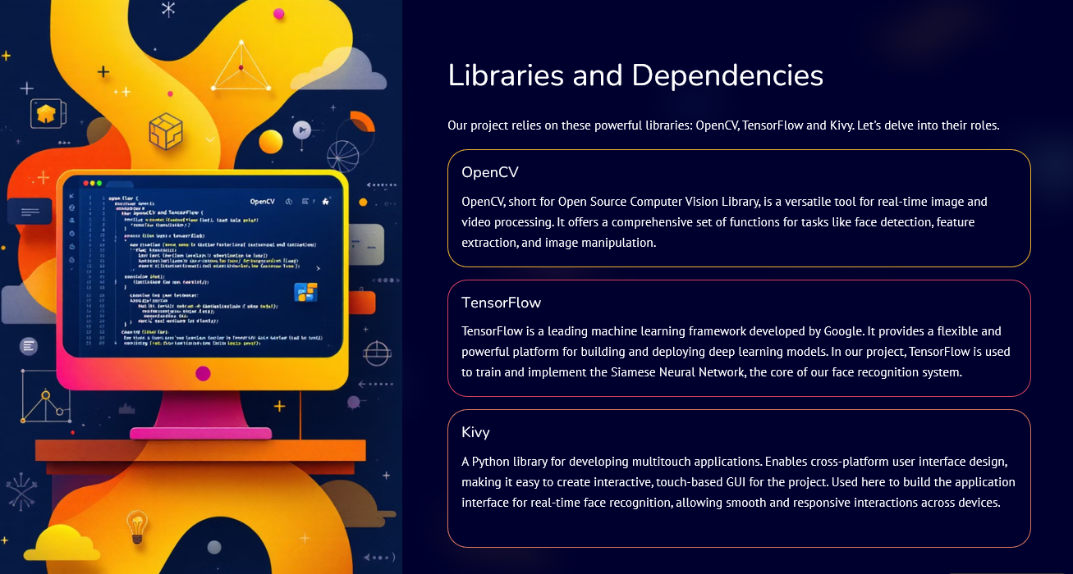

Slide 6
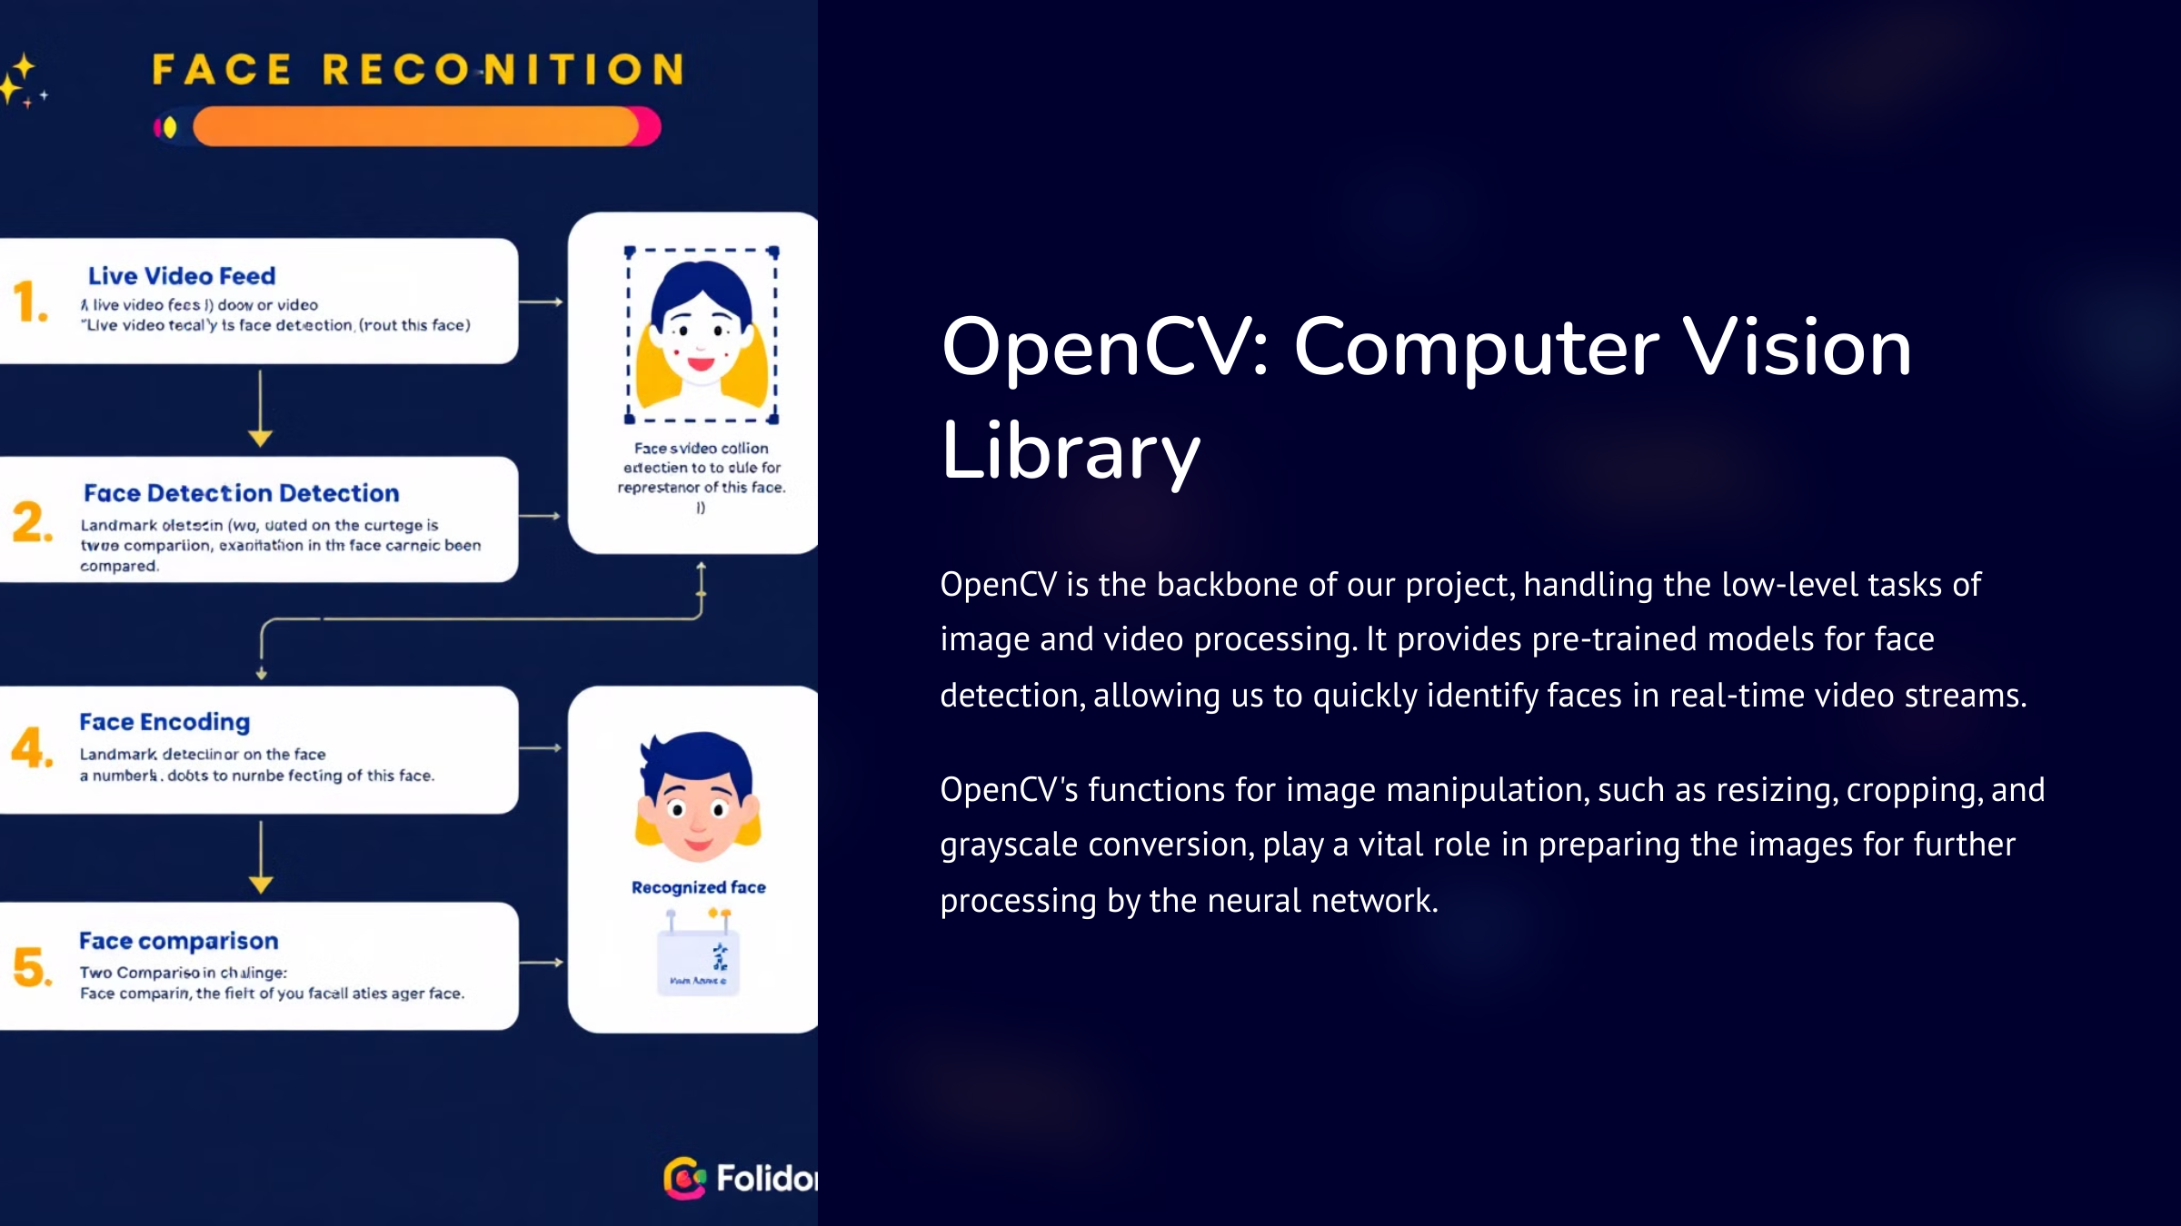

Slide 7
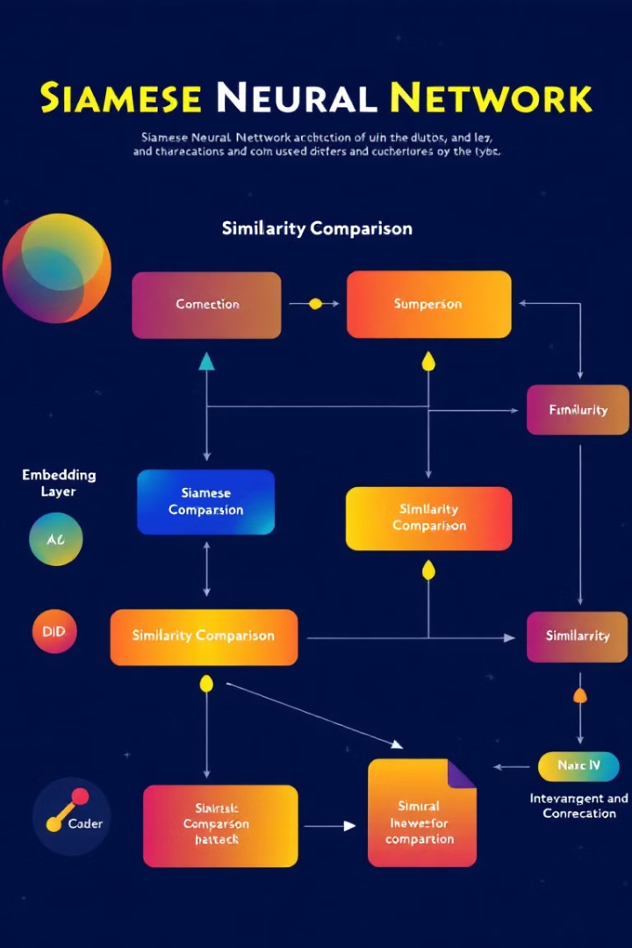
TensorFlow: Machine Learning Framework
TensorFlow empowers us to build and train the Siamese Neural Network, the core of our face recognition system. This network's architecture is specifically designed for comparing two input images to determine their similarity.
TensorFlow's flexible framework allows us to optimize the network's performance and choose appropriate training methods to achieve high accuracy in face recognition. The ability to run these models efficiently on both CPUs and GPUs is essential for real-time applications.

Slide 8
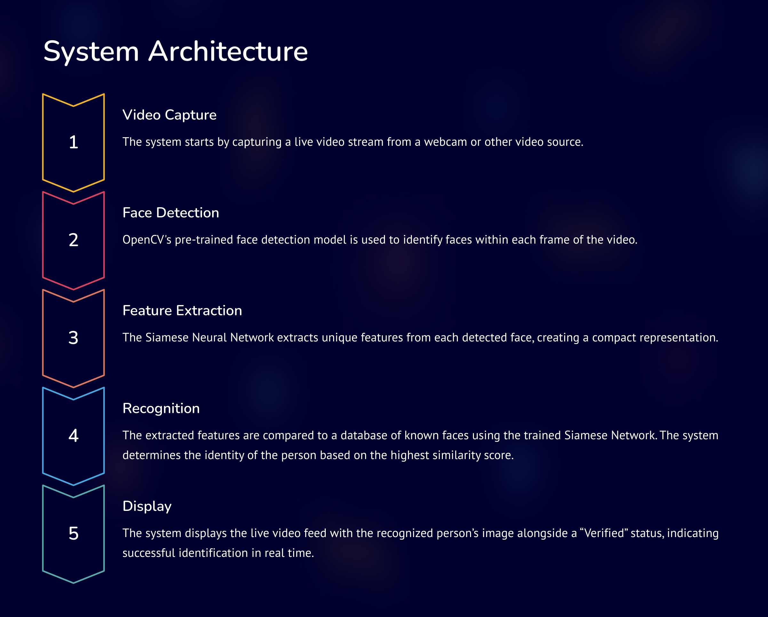

Slide 9
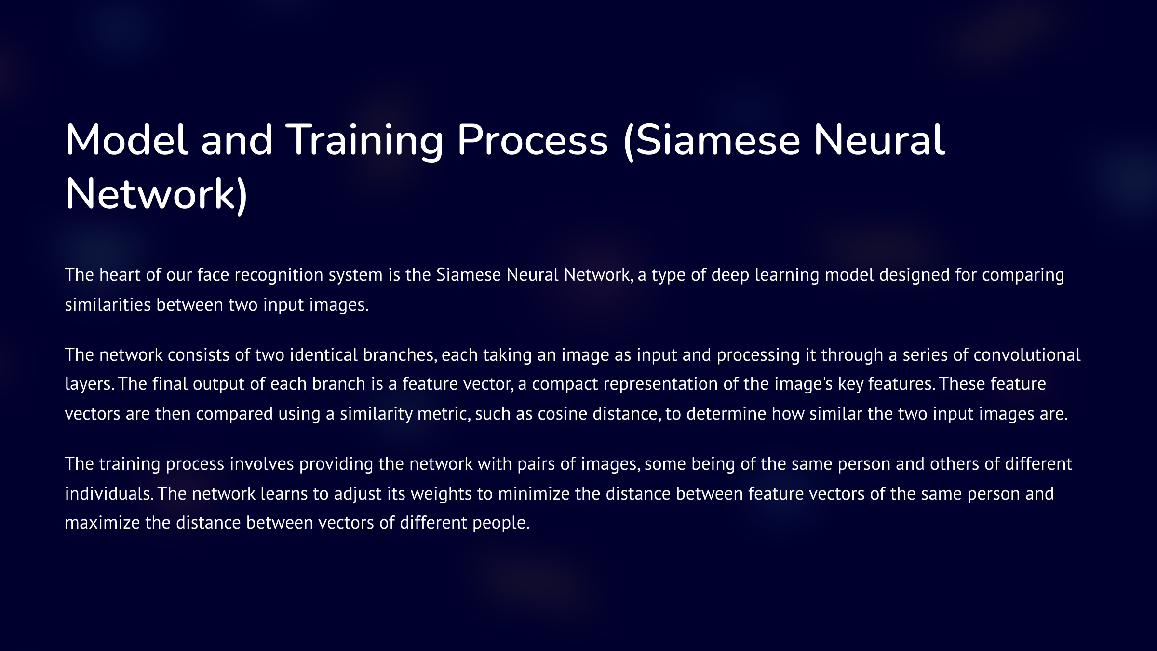

Slide 10
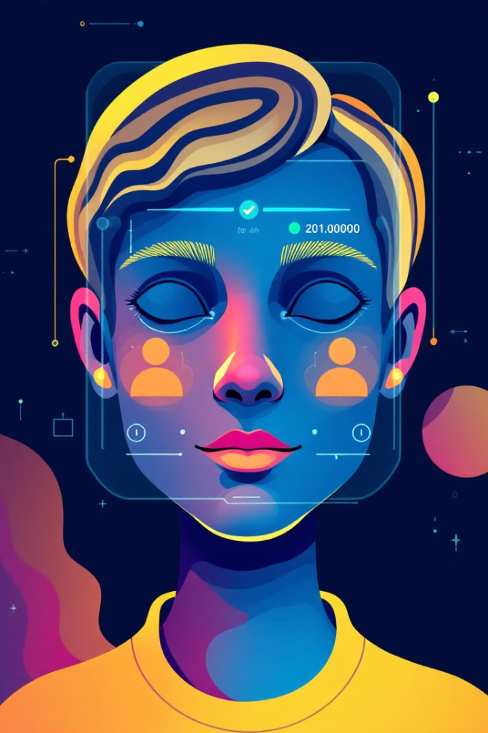
Conclusion
Our project demonstrates the power of OpenCV and TensorFlow for building real-time face recognition systems. The Siamese Neural Network, trained on a dataset of facial images, achieved high accuracy in identifying individuals.
This technology has a wide range of applications in various fields, such as security, access control, and even personal devices. Further research and development can lead to even more robust and efficient face recognition systems, expanding their potential impact on our daily lives.

